Slide 1
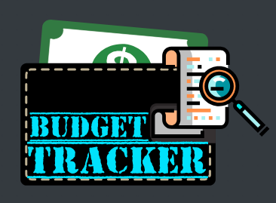
BudgetTracker

Slide 2

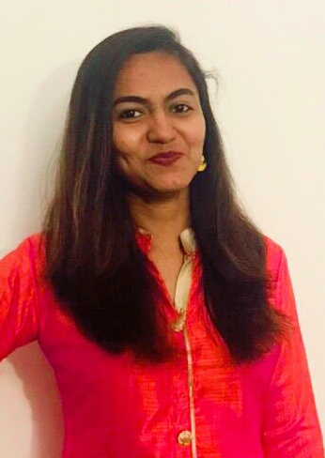

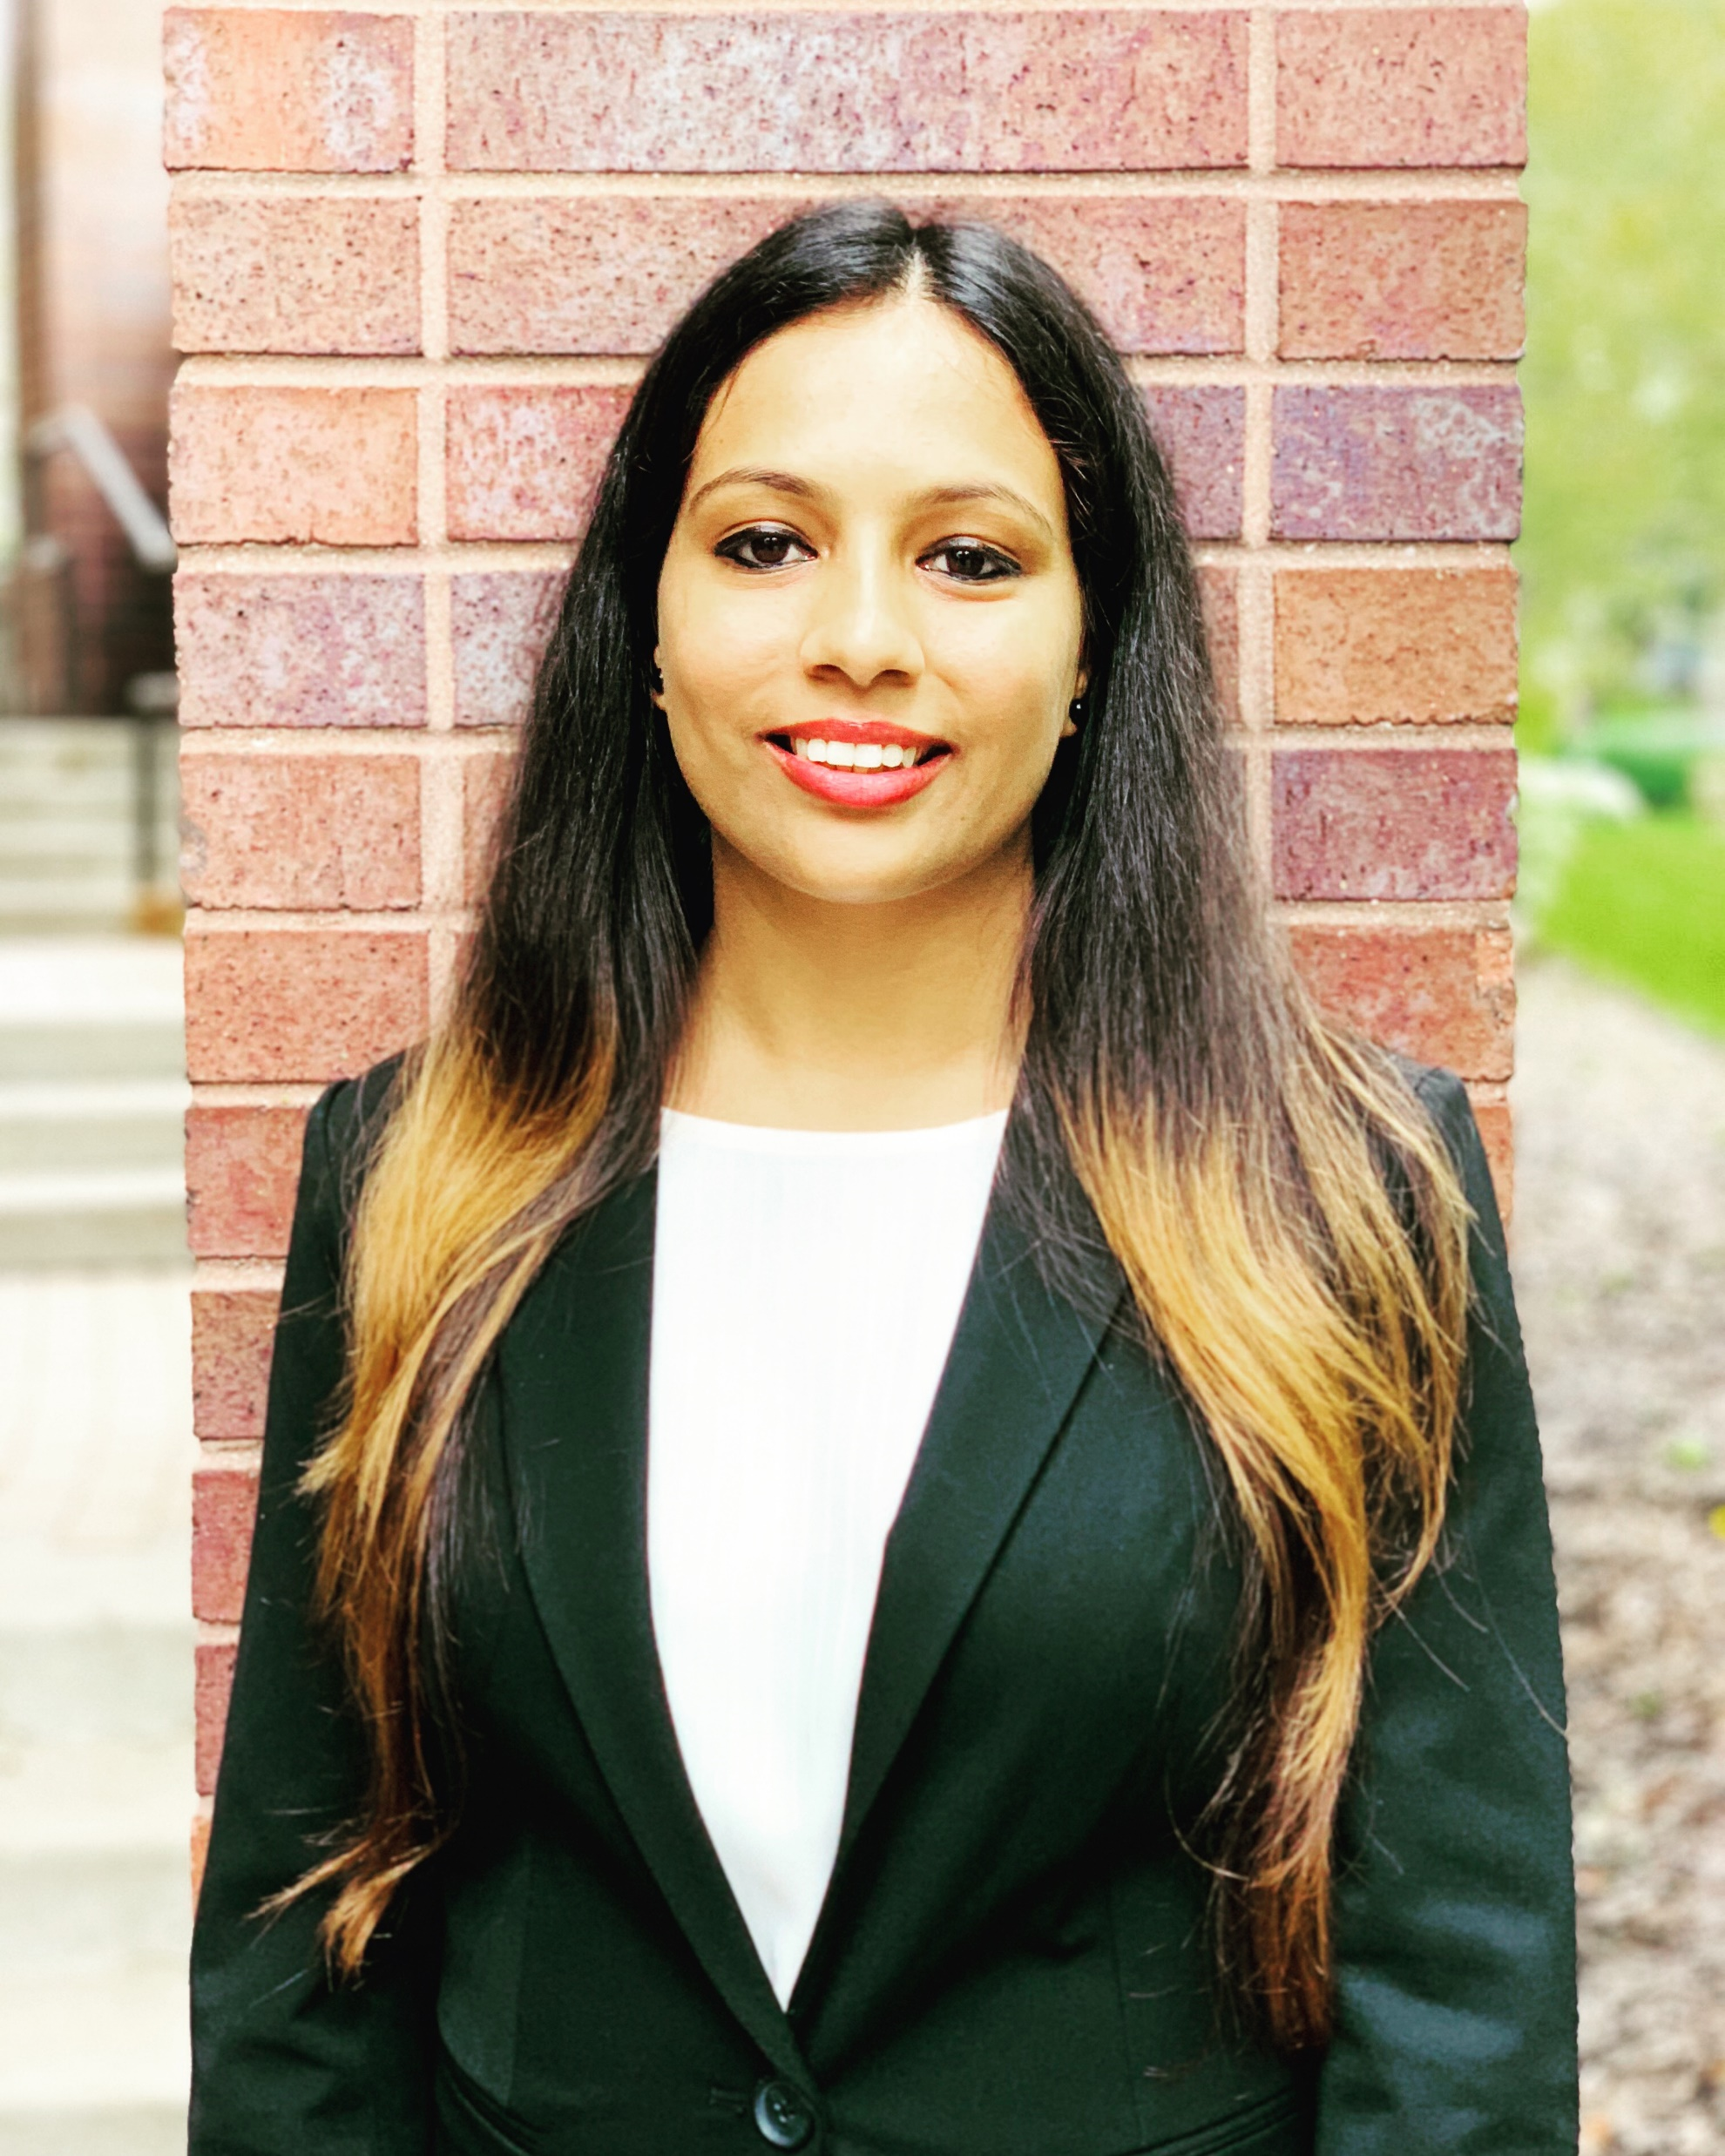
Team Members
Devesh Jain Janiece Pandya Shikha Soneji Rozy Gupta

Slide 3
Project Description
Budgeting is the process of creating a plan to spend one’s money and this spending plan is called a budget.
Creating this spending plan allows to determine in advance whether there is enough money to do the things needed to be done.
Budget Tracker will help to track the budget categories, budget plan for each month and actual expenses.

Slide 4
Measure of Ease of Learning
Budget Tracker focuses on “Easy to Learn” as it’s Primary E.
Including complex functions → bad user experience
Great User Interface and smooth navigation
Providing the users with a tutorial video

Slide 5
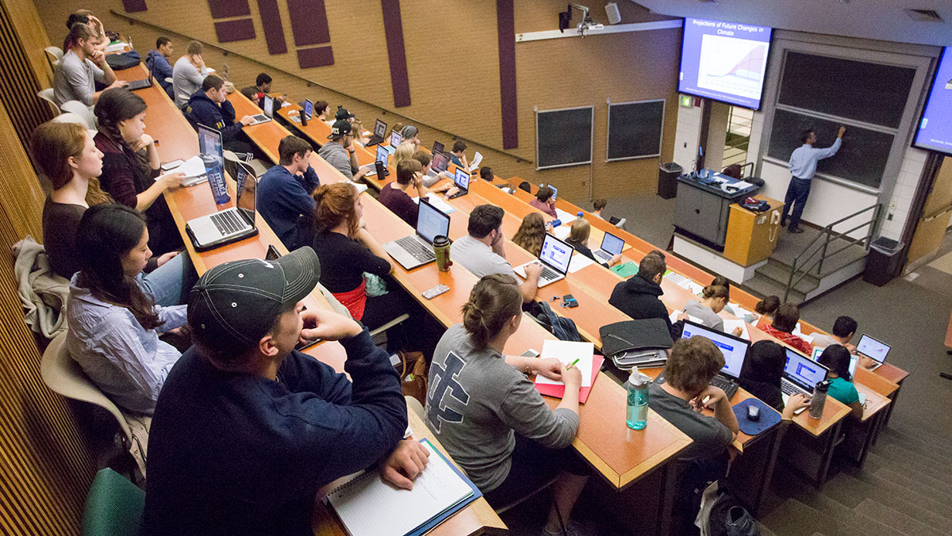
Target Population
Ranging from a student who is naïve in managing the personal expenses to the busy bees who don’t have time to keep a track of their monthly expense it is useful for all.

Slide 6
Purpose of building the Application
Need track of cash flow
Reckless spenders
Frequent unplanned expenses
Intended Savings

Slide 7
User Story
As a student, I would want an application to keep track my incoming and outgoing expenses as per my monthly schedule.
I would like the application to sync my account details so that I don’t have to recollect all my expenditures at the end of every month.

Slide 8

A typical user
Sam is a doctoral student at Stevens
Being a doctoral student, he does get some stipend for his living expenses. But despite that, it becomes difficult for him to manage what comes in and what goes out
Fixed expenses include his rent, utility bills, mobile bill, and groceries
Unplanned expenses include cab rides to campus and elsewhere, optional trips, restaurants and shopping
With a goal of about 50% savings from the income, he is not meeting it despite certain measures
With this in view, Budget Tracker is a necessity to curb expenses on certain things to ensure the goal is met.

Slide 9

The user’s story
It is the end of the month and I, Sam, am getting ready to head to the college. I live in New York City, so I need to catch a bus to reach my campus which is across the river, in Hoboken. I also realize that tomorrow is the 1st day of a new month, so I would have to pay the rent. I check my balance for the renewal of my monthly bus pass and the rent as well. That is when it struck me that I need to manage my expenses very well to ensure that I don’t end up in a financially pressing situation. I recollect that I had been suggested by my friend about this app, 'Budget Tracker'.
So, I use this app hoping to save some money. When I open the app, there is a Home page that says 'Hello'. I go to different options available and select the Budget Calculator. It asks me to fill my details such as: Monthly income (if any), Housing expenses like rent, TV, internet, gas, and electricity, Transportation expenses, if car - then gas or fuel, insurance, and monthly maintenance. If public transport, then monthly pass fare, Educational expenses like tuition fees or any loan, Food and personal expenses, like groceries, any medical or miscellaneous expenses and Monthly savings (if any).
I fill all the numbers in the boxes and then it shows me a graph of how much money I have been spending and where have I spent more. This way, I come to know exactly where the money in the whole month goes.

Slide 10
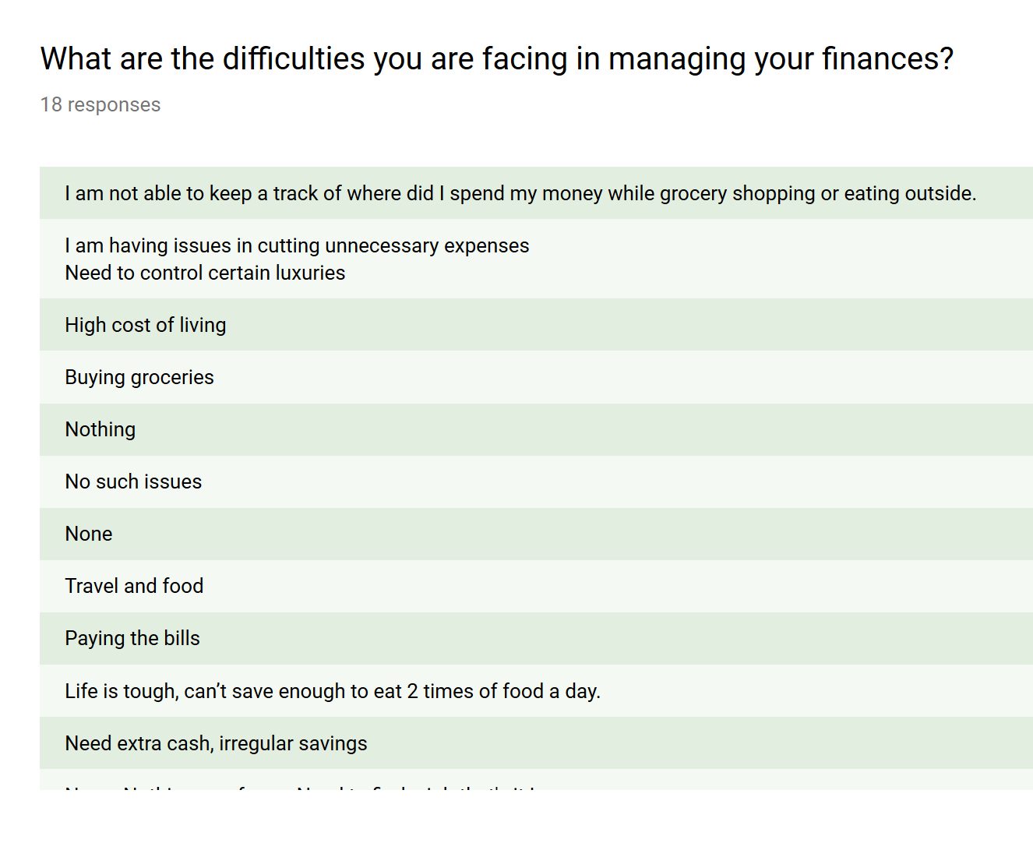
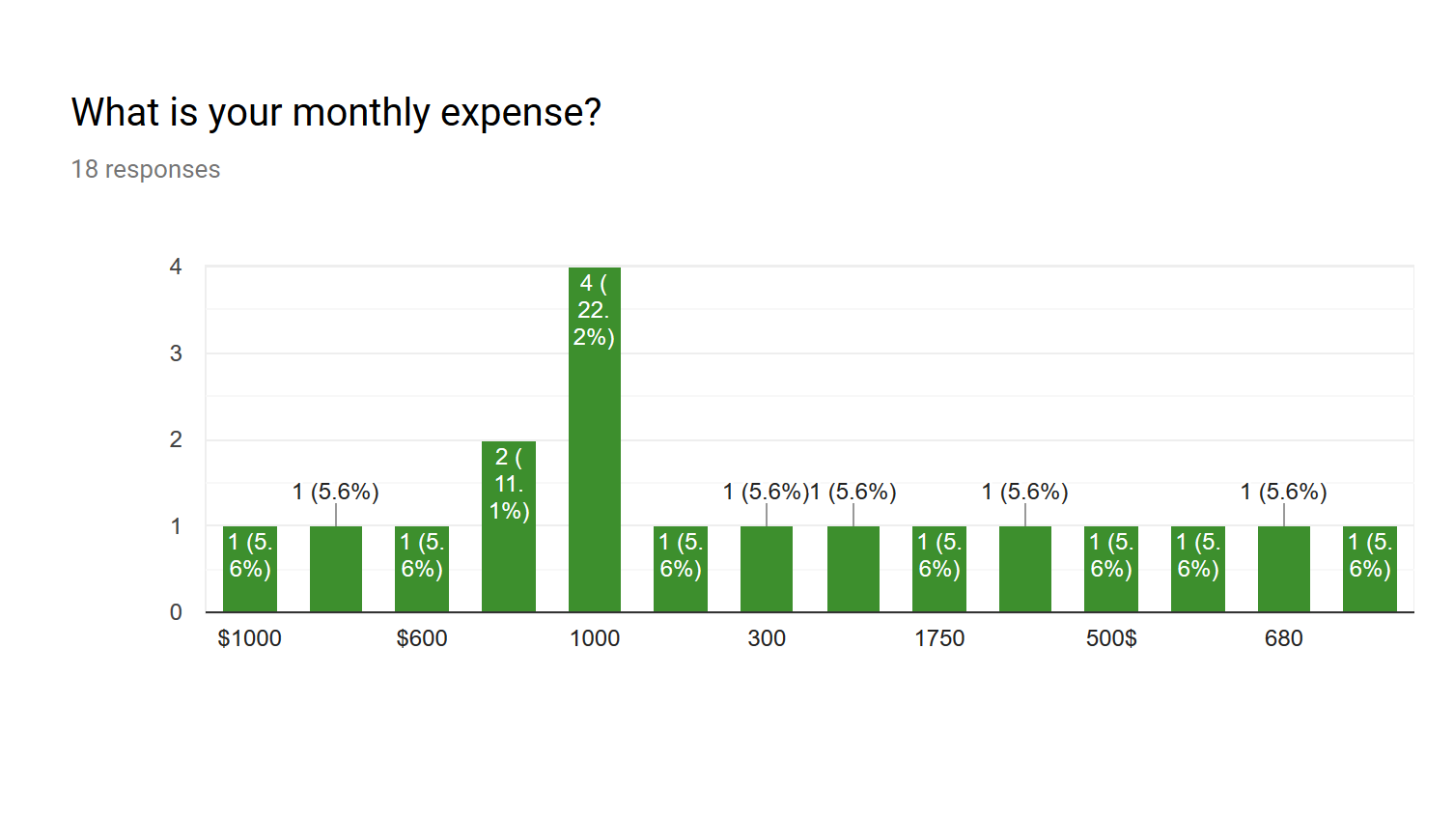
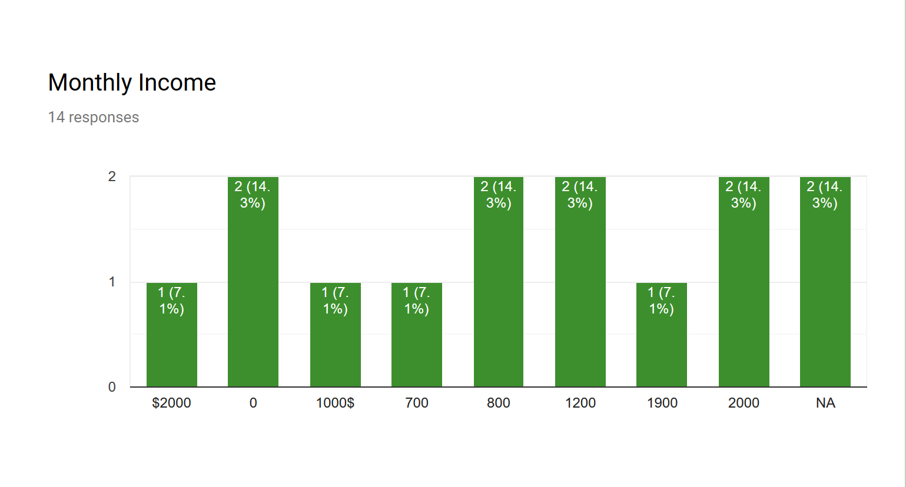
Questionnaire

Slide 11
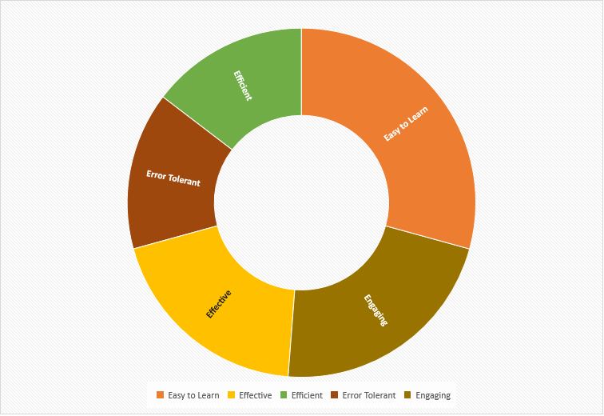
Success Criteria of this app

Slide 12
First Prototype
Very basic
Unattractive & Simple UI
Limited Options
Static Navigation Bar
Images and no videos for ‘How It Works’

Slide 13
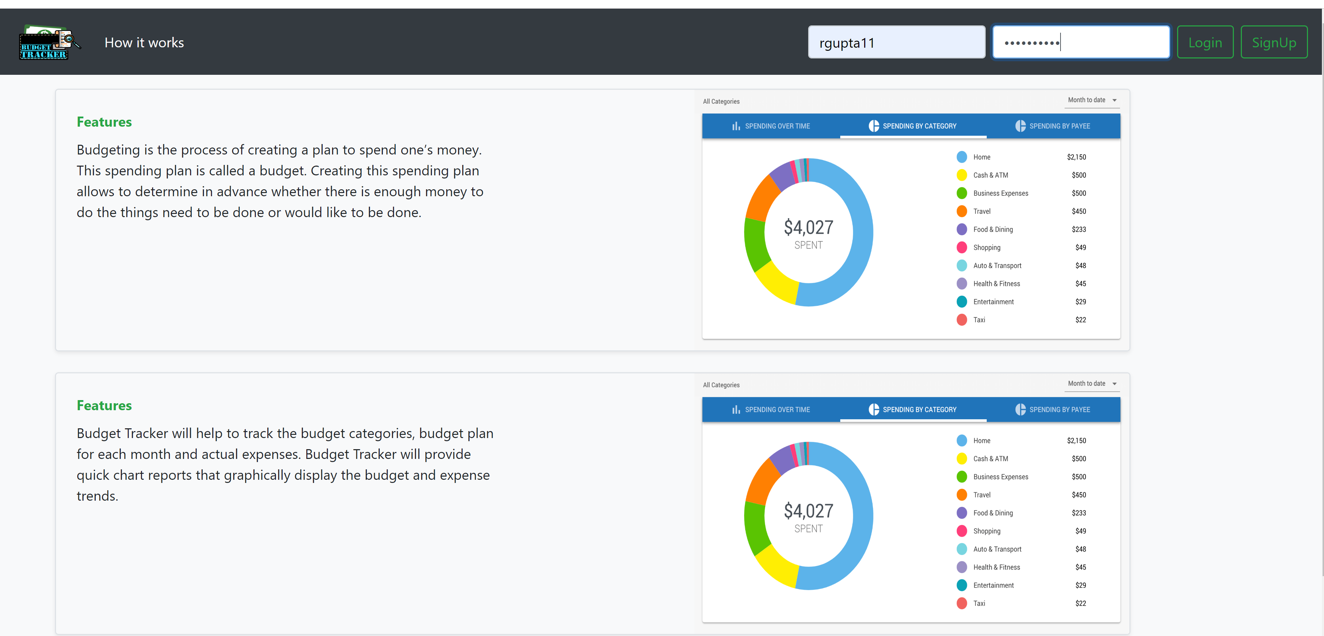
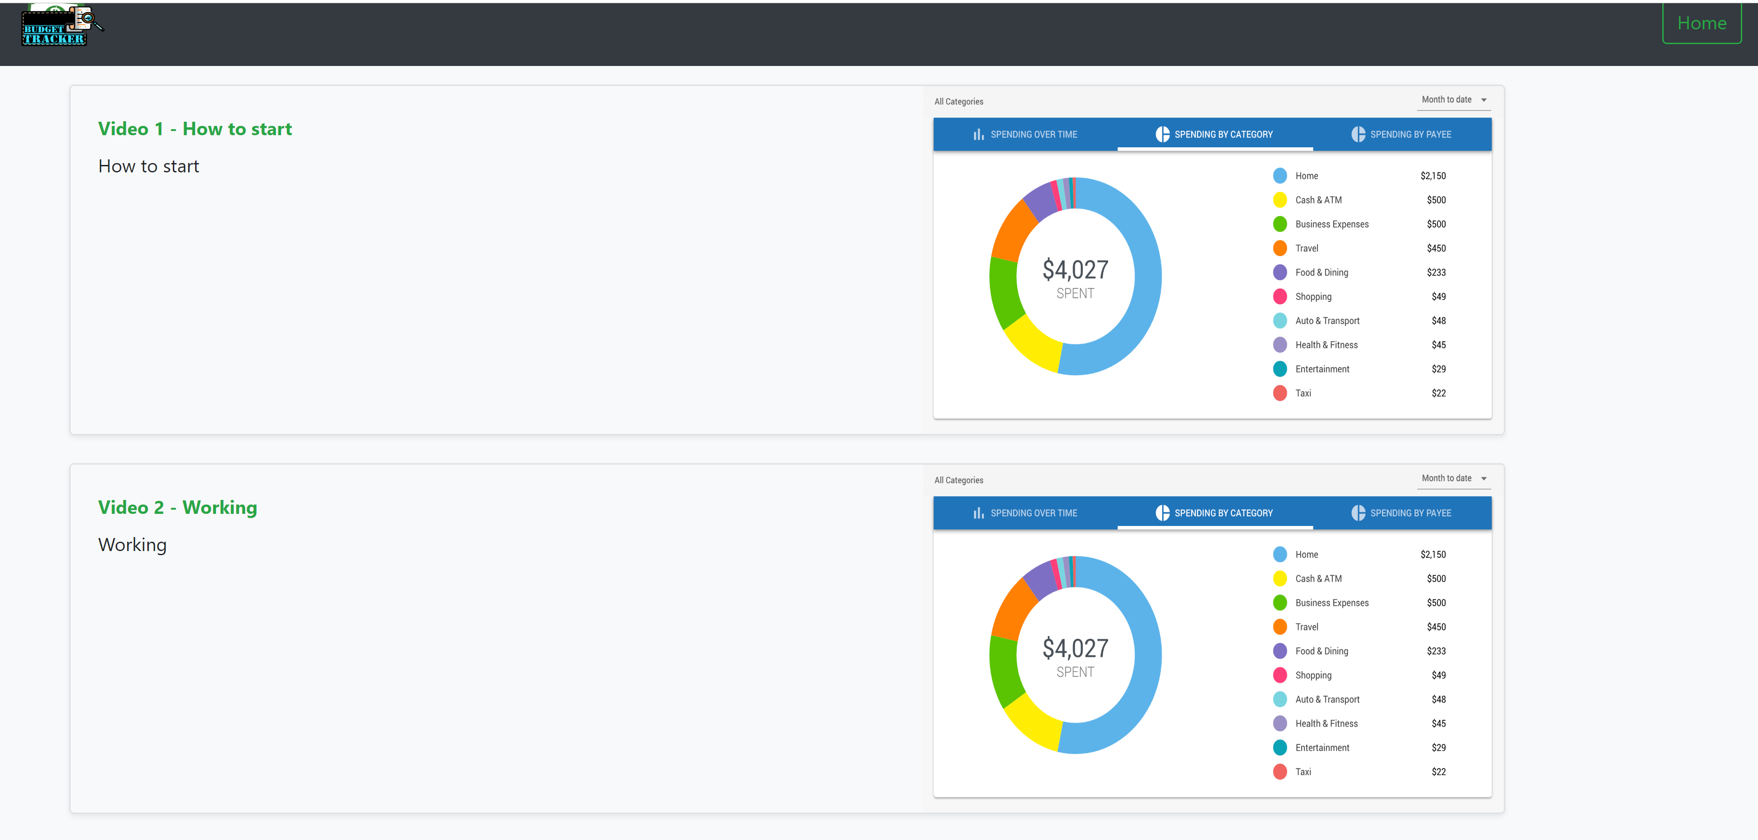
Iteration 1

Slide 14
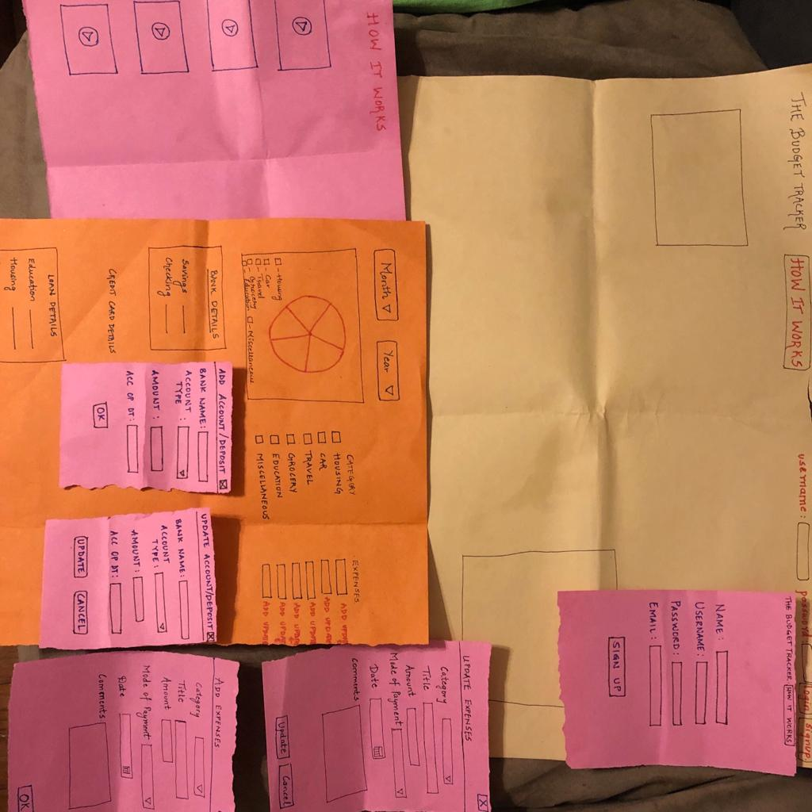
Paper Prototype
Basically to test our target E(Easy to learn).
Initially, we had 5 users to implement the paper prototyping.

Slide 15
Survey results and the changes made
Many feedbacks were taken from the users and the difficulties they faced were noted down.

Slide 16
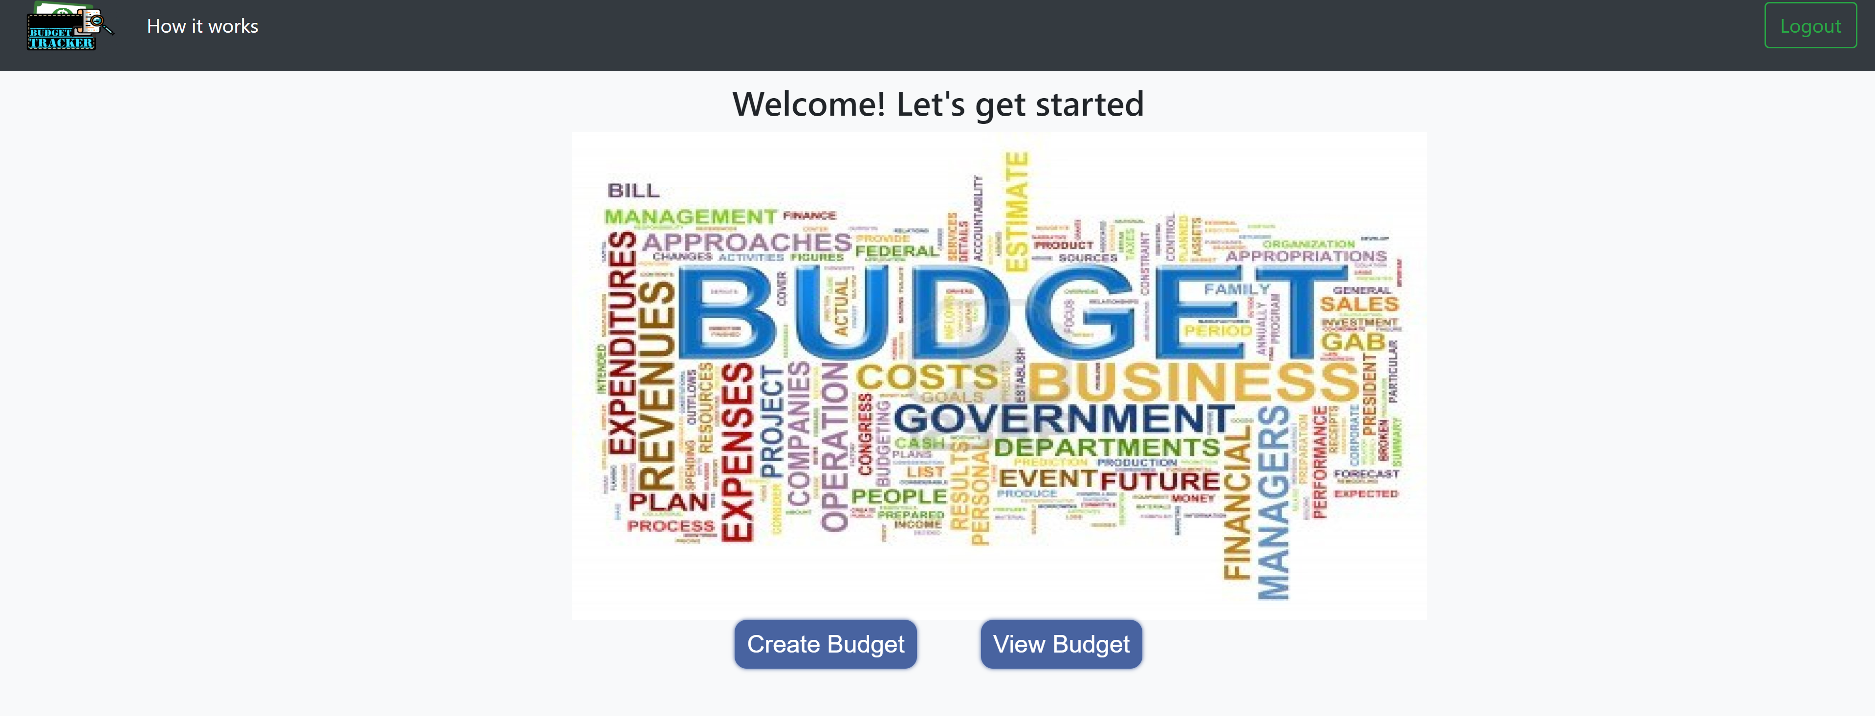
2nd Iteration
Navigation bar was static only on 2 pages.
Videos were uploaded and it starts playing after clicking on the image.
Pop ups were changed to different pages for the ease of navigation to various operations.

Slide 17
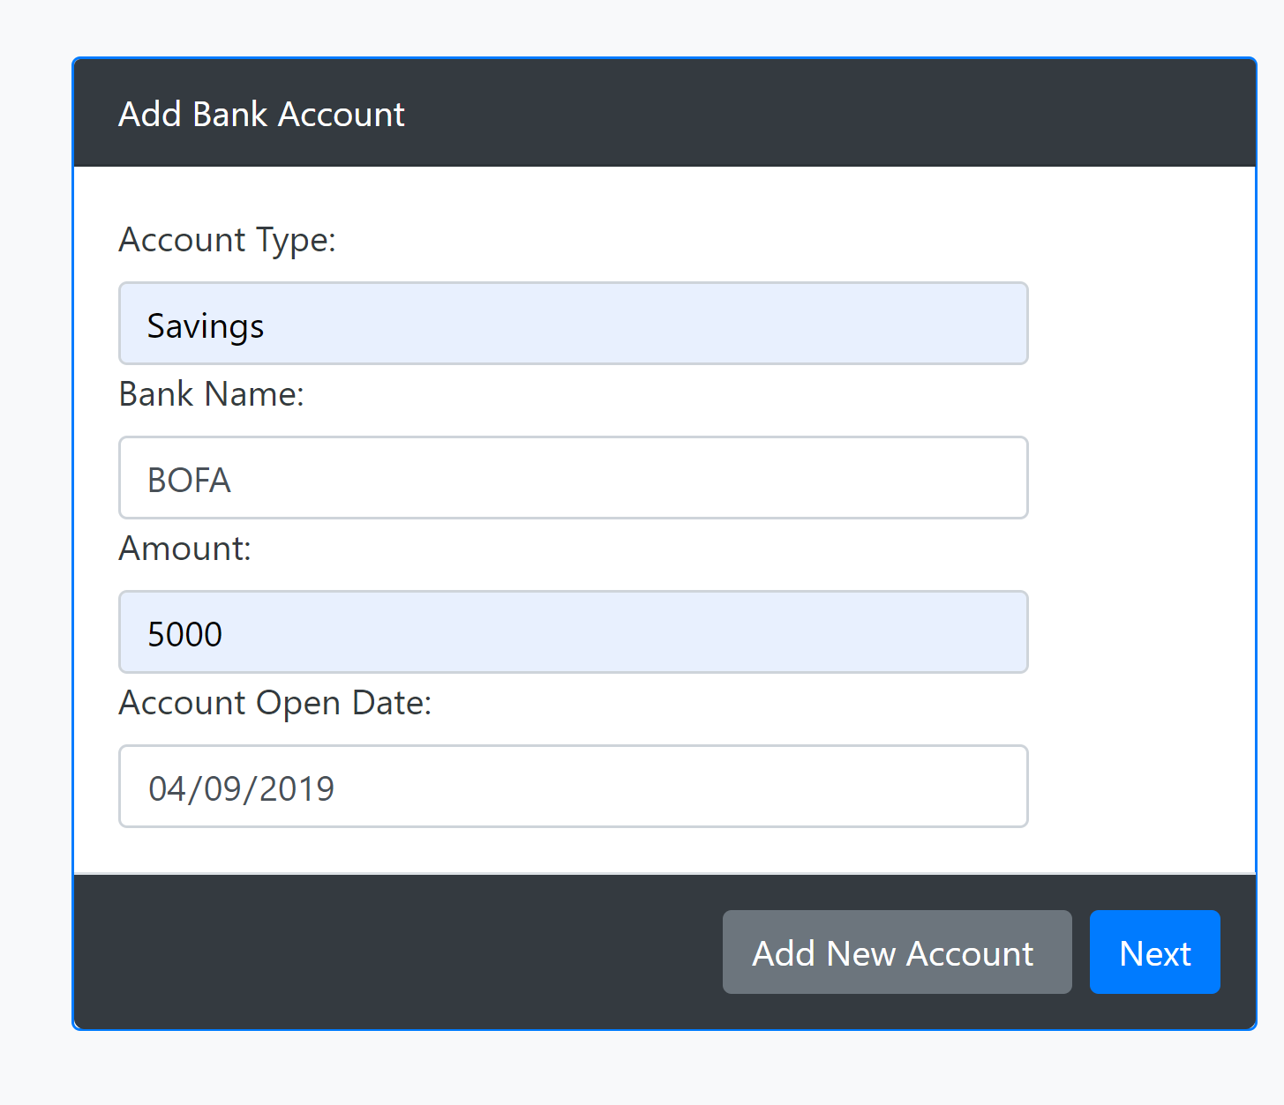
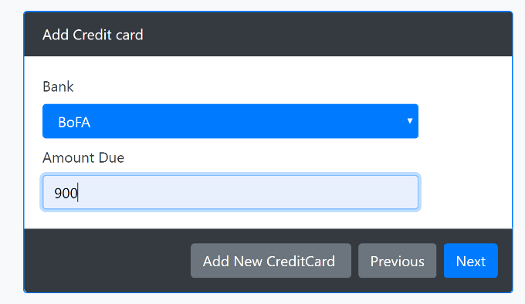
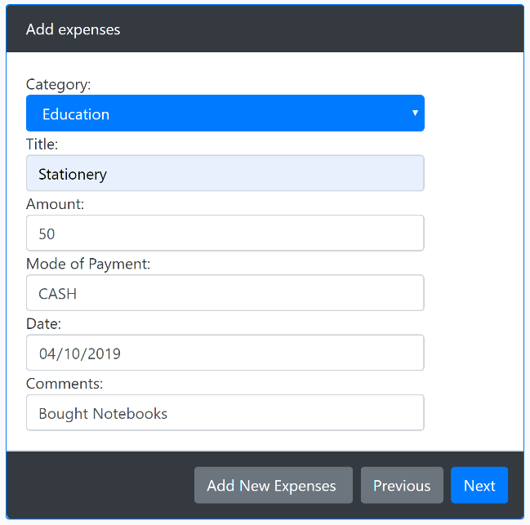
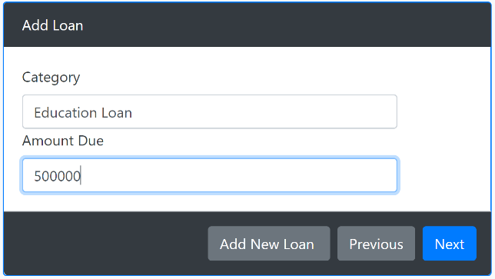

Slide 18
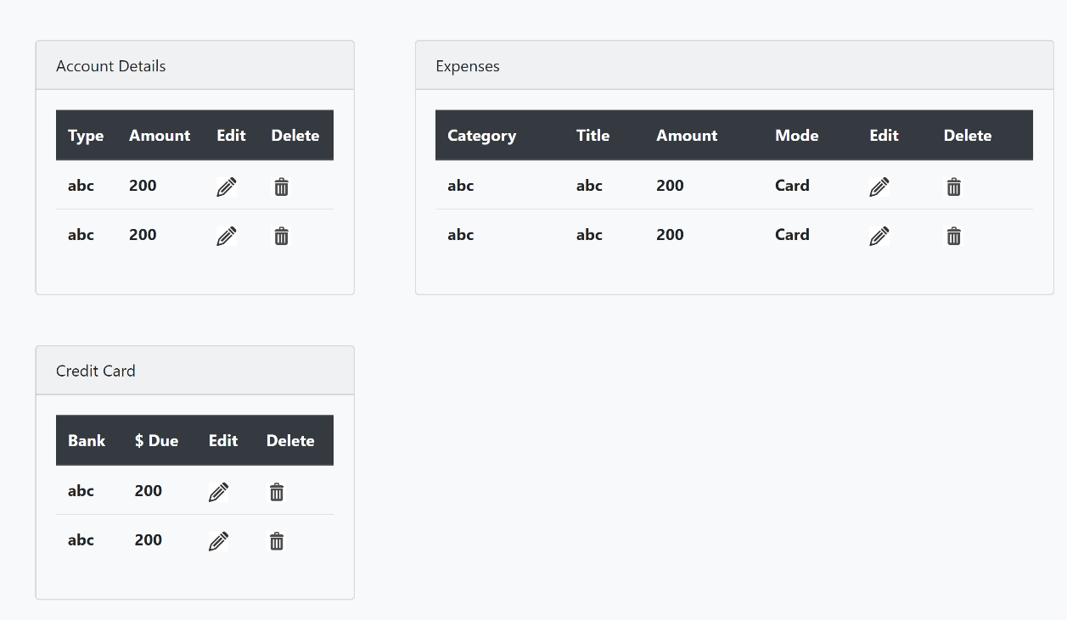
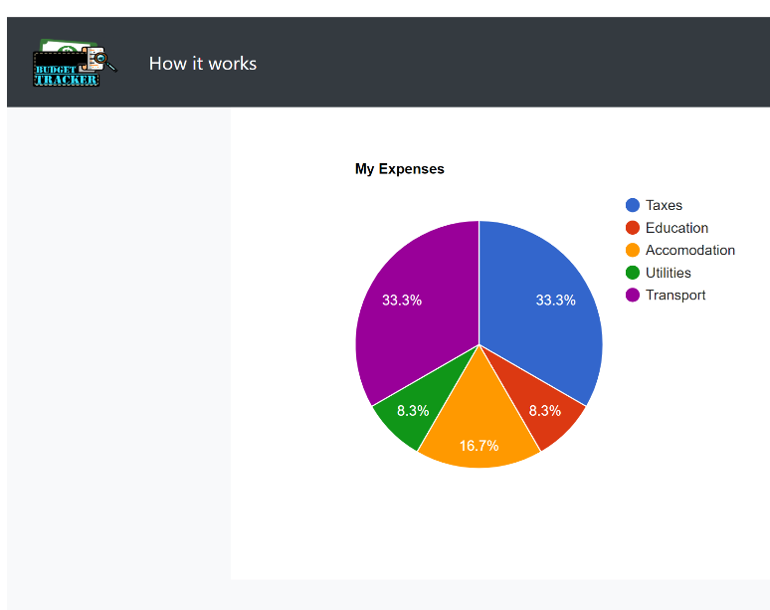
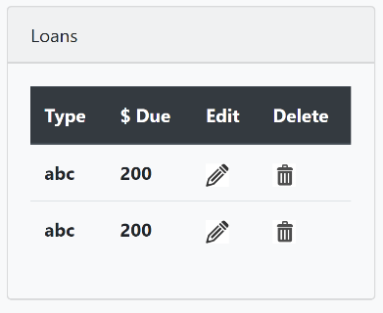
View/Edit your Expenses.
Pie Chart to view track the expenses

Slide 19
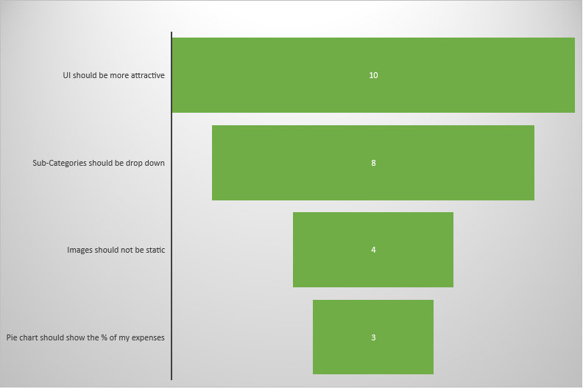
Survey results
A survey from 10 people was taken for the user testing of 2nd iteration. Some of the suggestions or opinions given by the users are shown above.

Slide 20
Final Iteration
Animations were introduced and the logo was added as our Home button.
Dashboard was changed to look more attractive
There was a 3D pie chart added for each user input

Slide 21
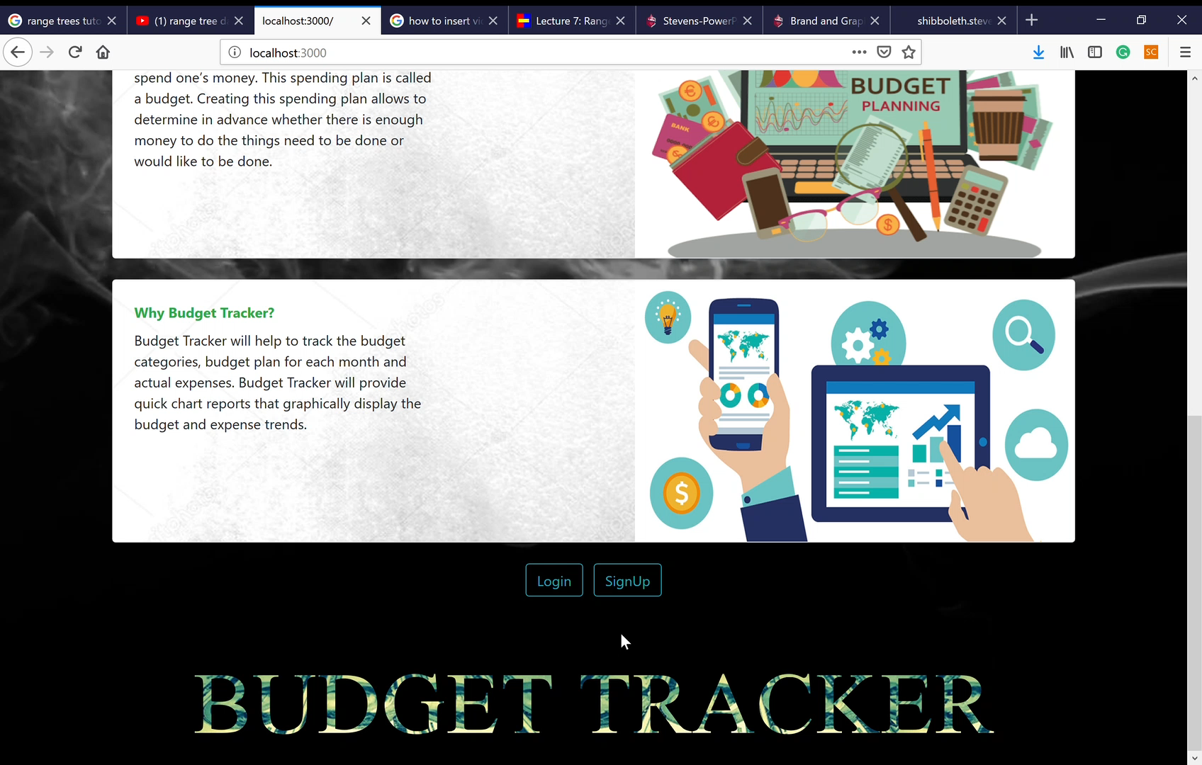
Carousel was added to make the UI more attractive.

Slide 22
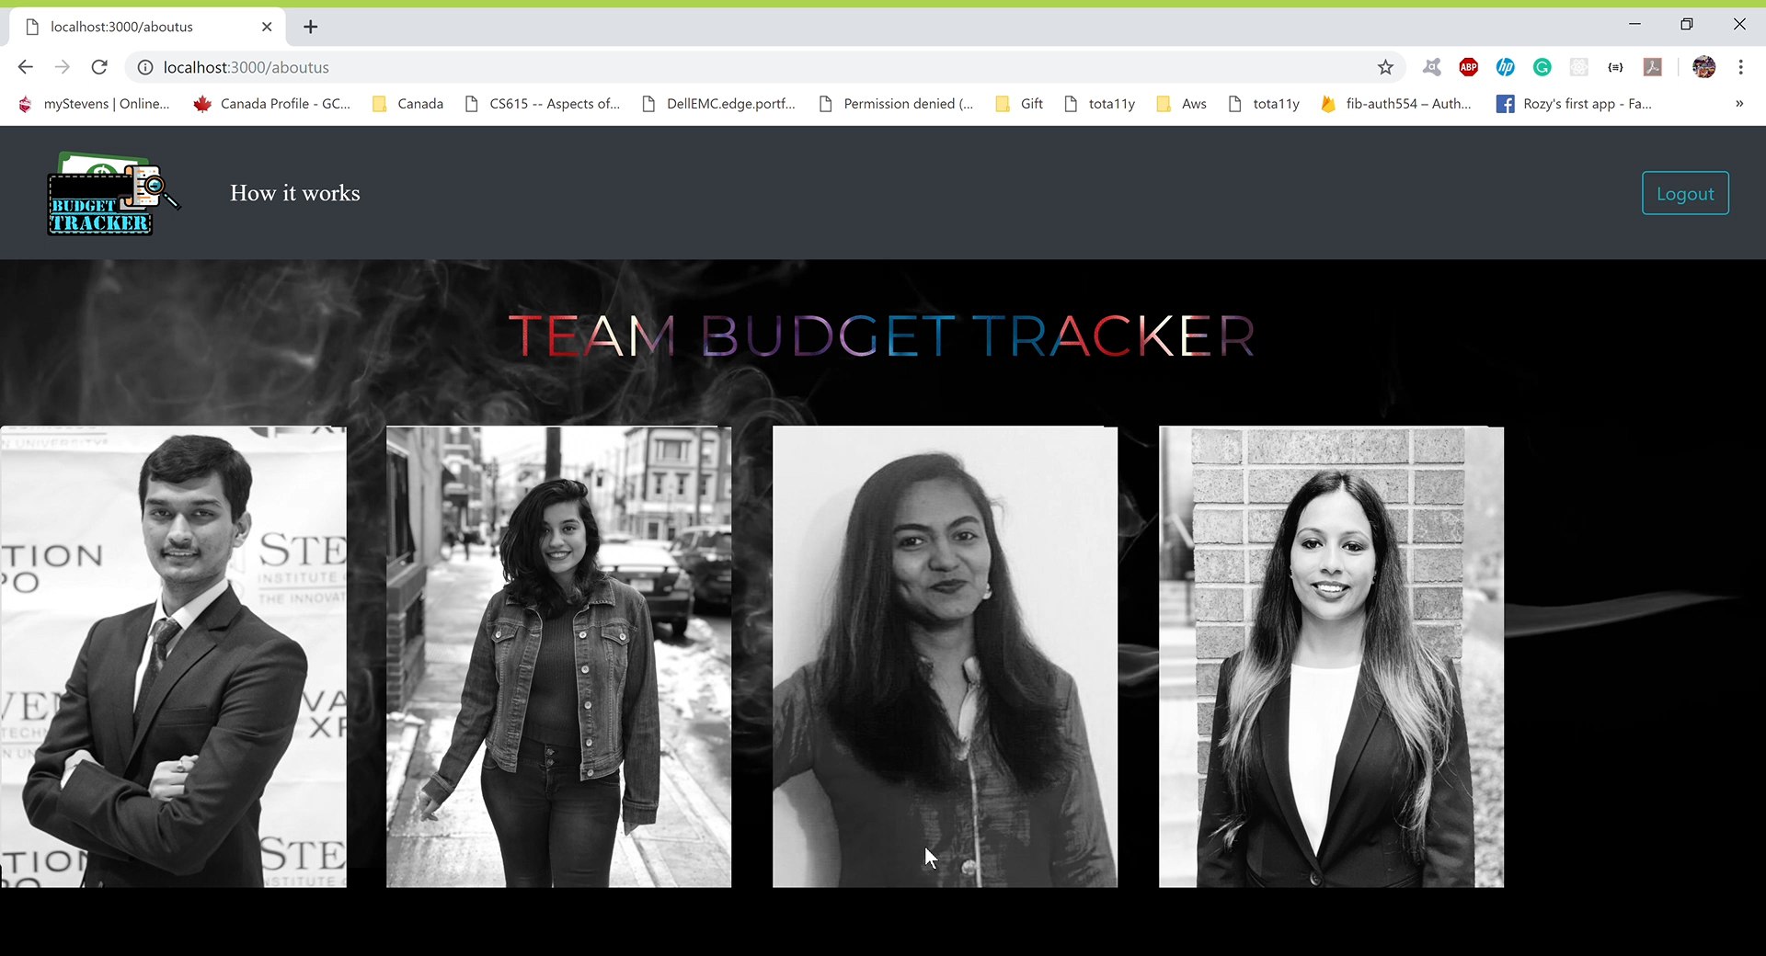
About Us

Slide 23
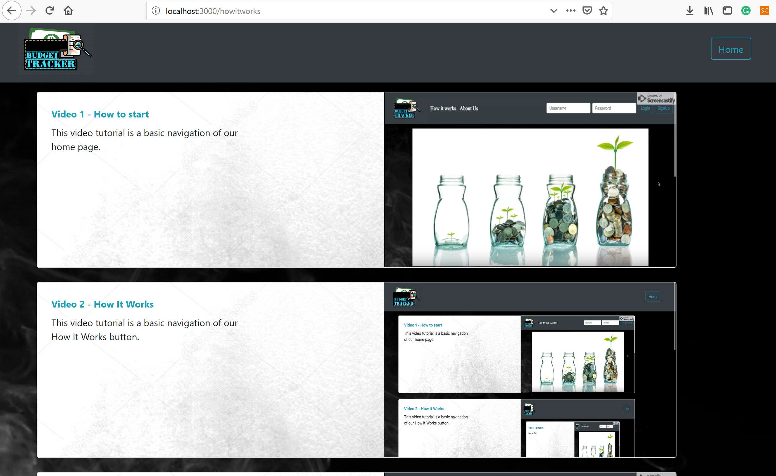
How did our E improve?

Slide 24
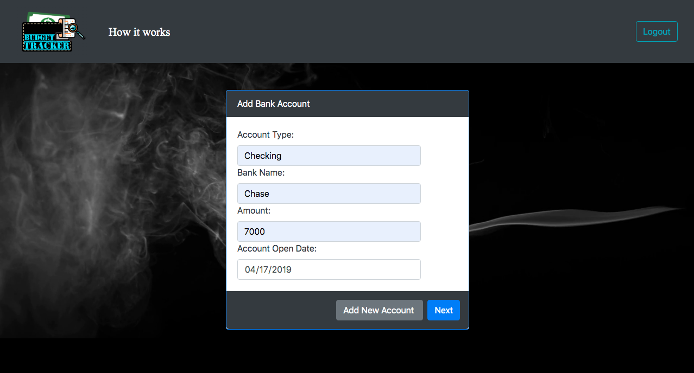
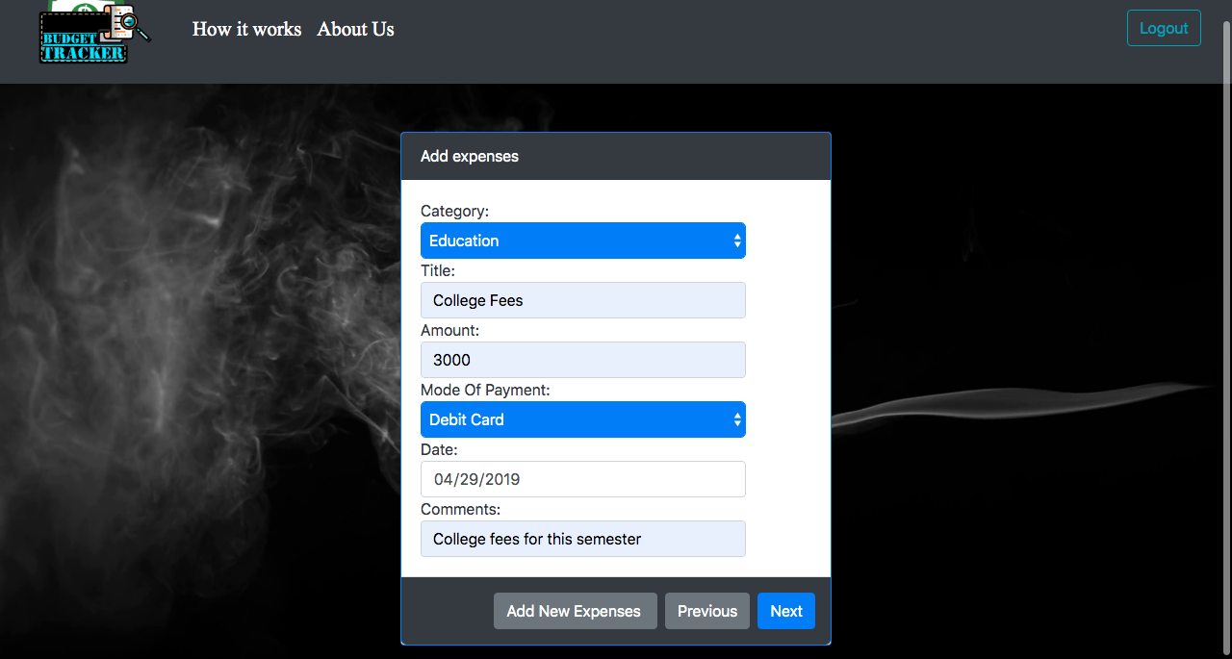
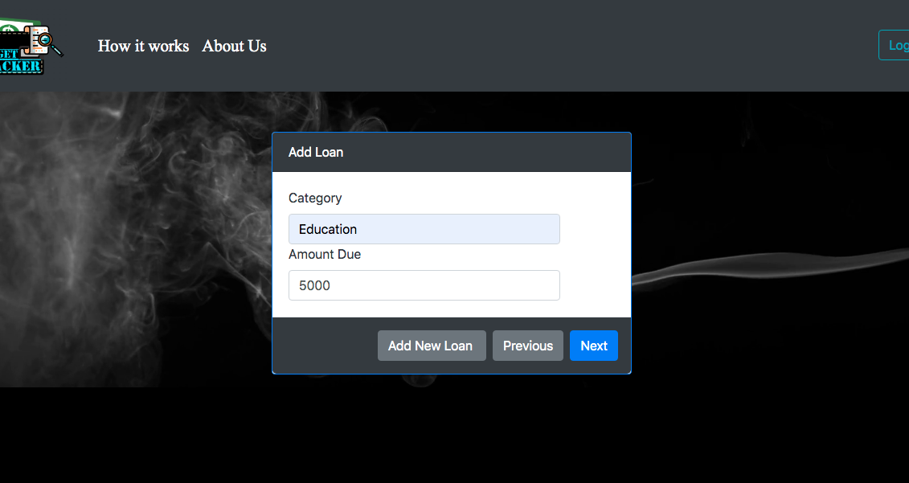
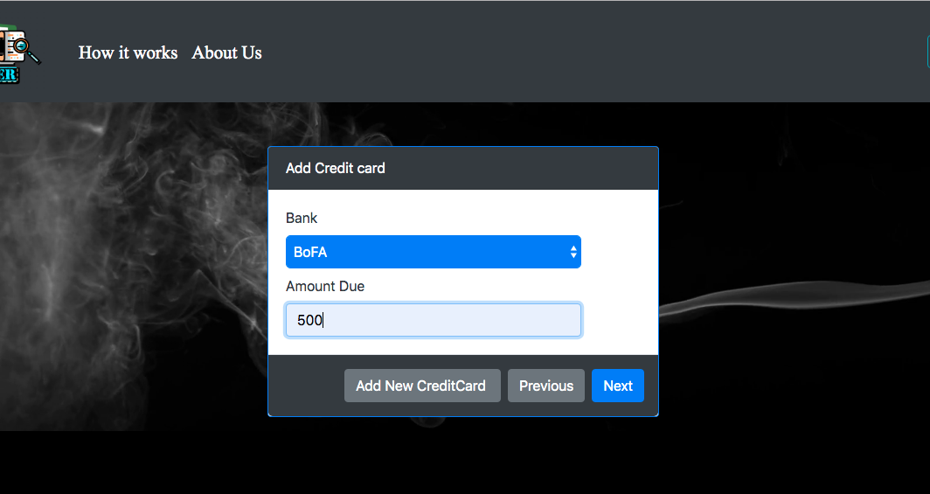

Slide 25
PAR review
Perception
Interaction is made interesting
Attention
Easy to learn and Affordable buttons
Retention
Videos and tutorials as reminders for anything that users forget

Slide 26
Heuristic evaluation
User’s feedback was necessary and the suggestions given by them were helpful in building this application.
Usability improvements as a result of user feedback include:
Improving the UI
Adding multiple categories
Allowing edits to the logged expenses
Synchronizing multiple accounts to keep a track of budget

Slide 27
Tidwell Patterns
Satisficing
Changes in midstream
Incremental Construction
Dashboard
Prospective memory
Personal Recommendations
Minimal Information

Slide 28
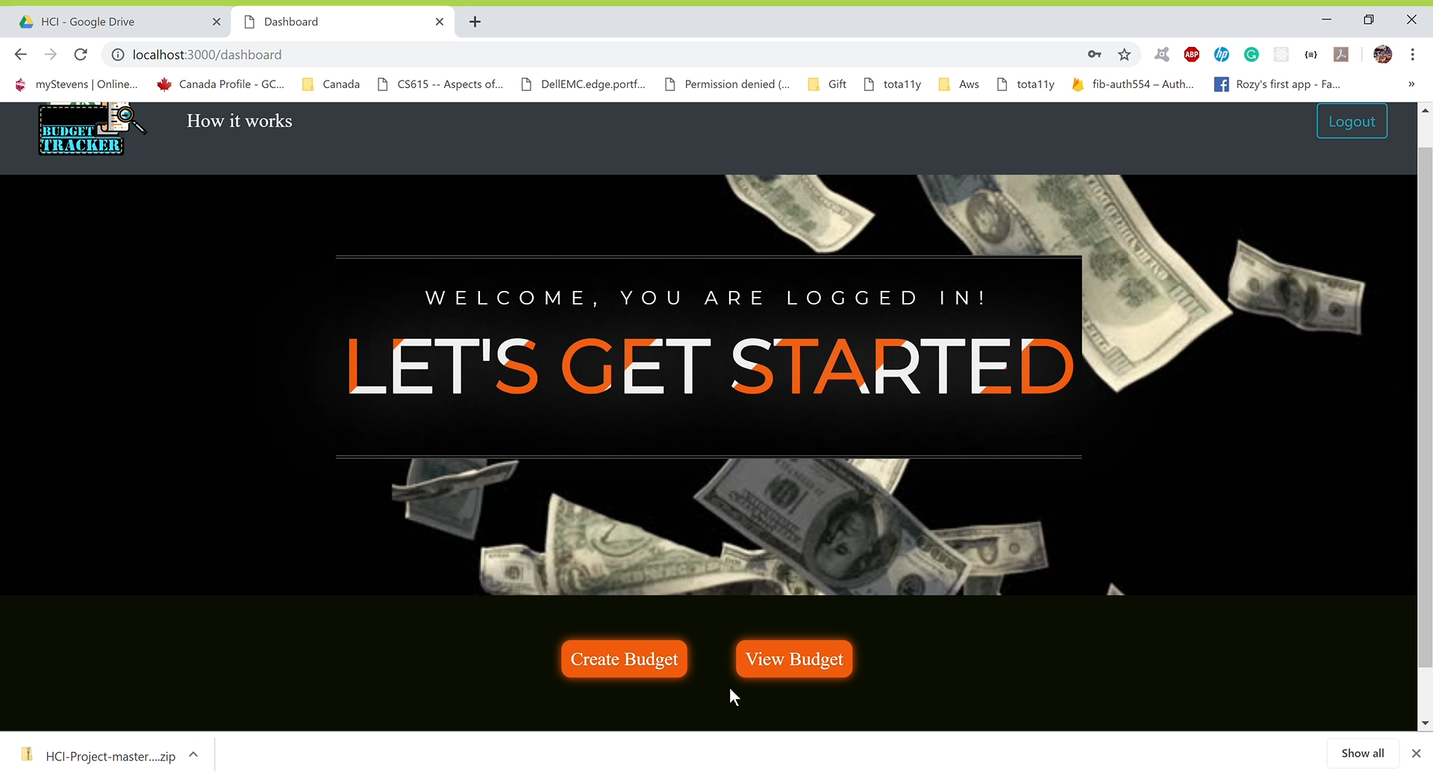
Microinteractions

Slide 29
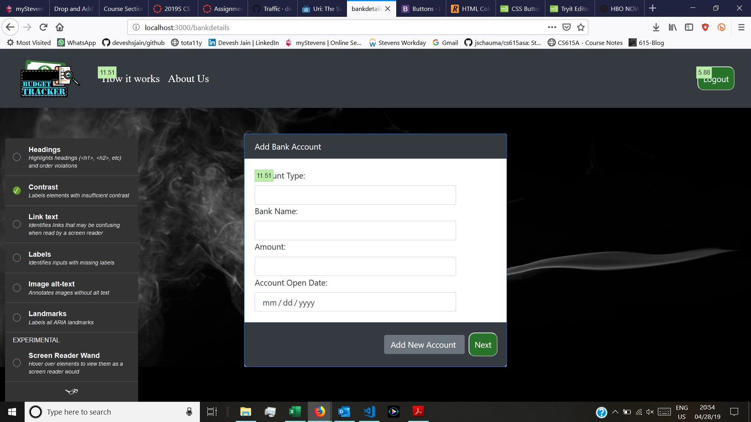
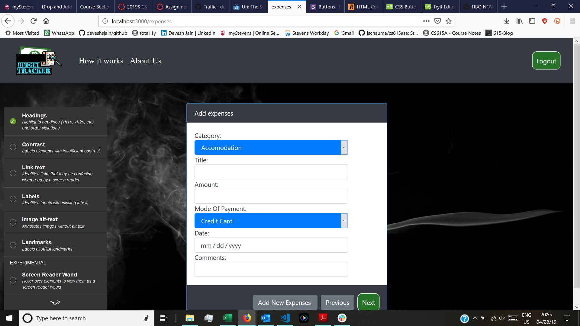
Accessibility

Slide 30
How did our E improve?
By keeping the UI simple
Posting short videos of every step for the user to learn
Affordable buttons

Slide 31
Any possible future improvements
Reminders
We intend to add a survey button for the user to give their feedbacks after using the application
User reviews and easy access for the registered users would be an add-on

Slide 32

Any Questions?

